Slide 1
Analyzing Tone

Slide 2
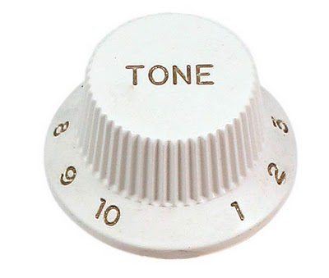
What is Tone?
Tone, simply defined, is the attitude the author has towards the subject of the work he/she is writing.
How does the author feel about the subject of the text?

Slide 3
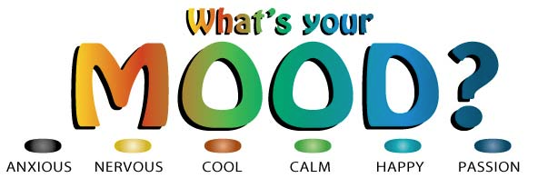
Mood
Mood is the atmosphere of the text; it is the emotions aroused in the reader.
What emotions/feelings do you have as the reader?

Slide 4
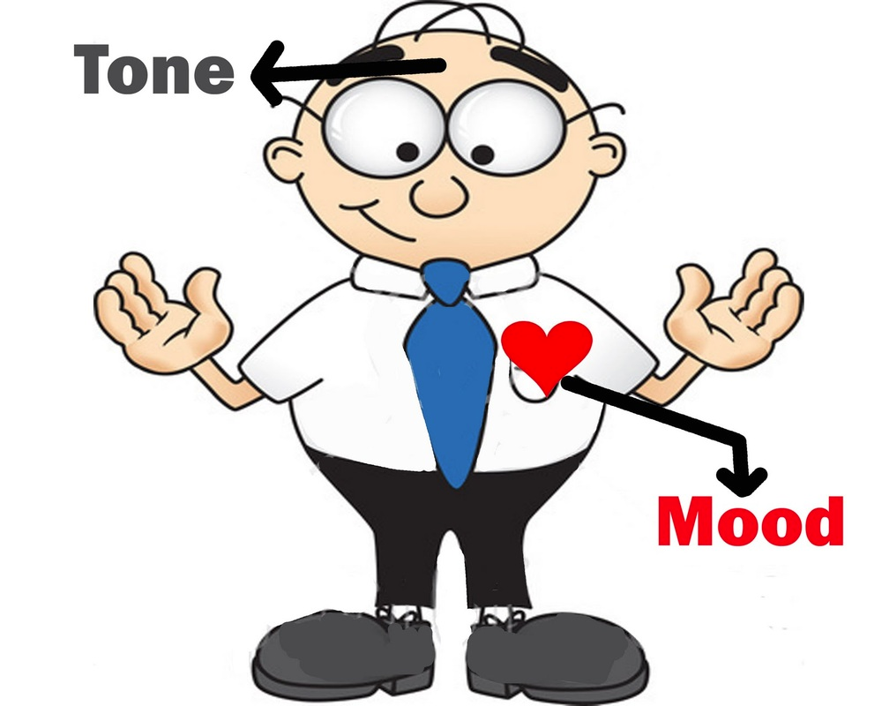
Tone & Mood: What’s the difference?
Whereas the tone deals with what the author thinks about the text, mood deals with how the reader feels.

Slide 5
How do I explain the tone?
Positive
Negative
Humorous/Ironic
Amiable
Authoritative
Joyful
Lighthearted
Romantic
Enthusiastic
Compassionate
Accusing
Aggravated
Arrogant
Bitter
Cold
Condescending
Disgusted
Passive
Amused
Bantering
Comical
Critical
Satiric
Taunting
Mocking
Facetious

Slide 6
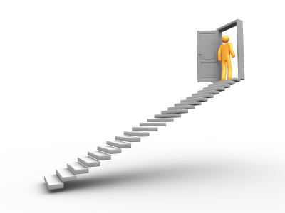
How do I identify and analyze tone?
4 Steps to identify & analyzing tone
Diction
Imagery
Figurative Language
Syntax (sentence structure)

Slide 7
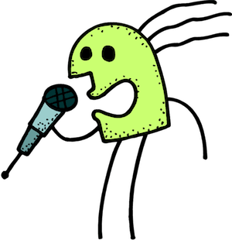

1-Diction: What is it?
In Speaking = Pronunciation
Text = Word Choice

Slide 8
1-Diction: How do I analyze it?
Abstract vs. Concrete
General vs. Specific
Formal vs. Informal
Can’t be perceived with senses
Perceived and measured
Vague
Precise
Long, technical and often unusual
Understood by majority of readers
Allow reader have a wide range of imagination
Make reader imagine specific thing
“Tell”
“Show”
Character perceived as educated
Character is relatable to the reader
Ex:
Pleasant
Ex:
Yellow
Ex:
Car
Ex:
Mustang
Tendentious
Biased

Slide 9
1- Diction: How do I analyze it?
Denotation- literal meaning/dictionary definition of the word
Connotation- The feeling or idea a word brings to mind along with the denotative meaning
Twilight vs. Dusk
Dog vs. Pooch

Slide 10
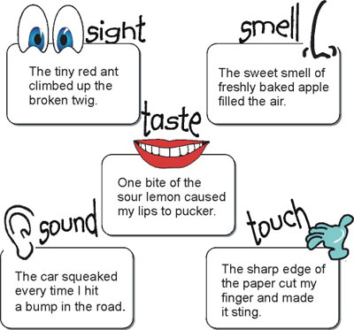
2- Imagery: What is it?
Imagery is the use of figurative language meant to appeal to the senses in order to place the reader in a scene or deepen understanding through feeling.

Slide 11





2- Imagery: How do I analyze it?
What senses are they appealing to? Figurative Language?
The lake was left shivering by the touch of morning wind.
The eerie silence was shattered by her scream.
He felt like the flowers were waving him a hello.
He knew a storm was coming, the smell of moss and moisture told him it would arrive soon.
The iron taste in her mouth was an indicator of fresh blood.

Slide 12
3- Figurative Language: What is it?
Google Definition: “Figurative language is a tool that an author employs to help the reader visualize what is happening in a story or poem. Some common types of figurative language are: Onomatopoeia, Alliteration, Hyperbole, Simile, Personification, Metaphor, Personification, Analogy, Euphemism.”
Figures of Speech
Sounds
Rhetorical Devices
Metaphor
Simile
Personification
Onomatopoeia
Alliteration
Pun
Hyperbole
Allusion
Repetition

Slide 13
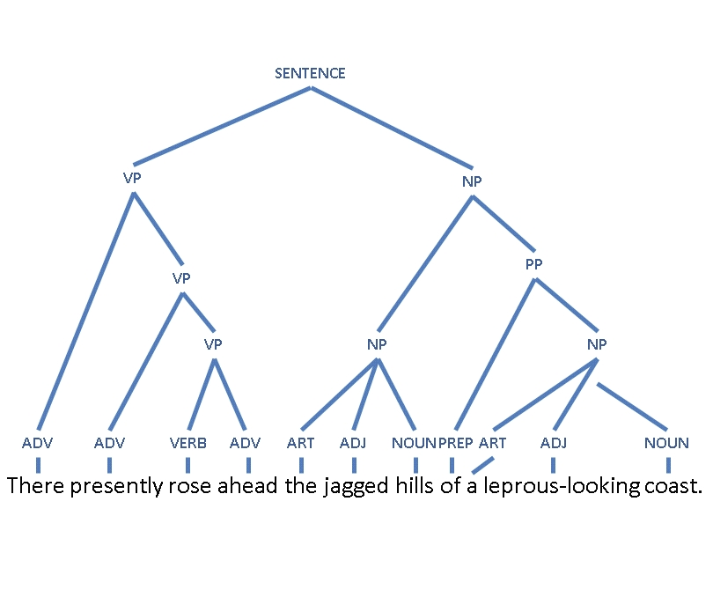
5-Sentence Structure: What is it?
Refers the construction of the sentence (AKA-Syntax). Rather than look at specific words, look at how sentences work together throughout the piece.

Slide 14
5- Sentence Structure:
How do I analyze it?
Word Order- End of sentence tends to have more emphasis.
“John bought flowers” vs “Flowers were bought by John”
Short- More intense and immediate. Short dialogue can make character look disrespectful, whereas long sentences can make them seem more thoughtful.
“No thanks” vs. “I’d rather not; however, thank you for the offer”

